Slide 1

Method-trace Analyser
Problem Statement - 2

Slide 2

Team Name
JavaMonks

Slide 3

Problem Statement: Method-trace Analyser
An application to assist the developers in debugging.
This problems is designed with a view to simplify the debugging and also provide clear graphical view of more than two log files.
This application has four major modules:
1. Anomalies between multiple files (Batch Anomalies) and One to Many Anomalies which compares a passing log with multiple failing logs.
CodeFlow (which shows the sequence of the methods during runtime)
Method time invocation for each method in milliseconds
Number of times each method executed.
jStackTrace (for getting java stack trace from the specific error or function)
Each module will show the table as well as graph in order to make comparison more easier.

Slide 4
Role of each Team Member
Manjot Singh Sidhu
Christ Deemed to be University, Bengaluru (B.Tech CS 3rd Semester )
Solution Architecture, Design and Development
Project Lead

Slide 5
Tools/Platform/APIs used
Tools/Platforms:
Windows, LINUX
OpenJDK 8
NetBeans IDE 8.2
Apache Maven 3.39
JAVA FX with FXML for GUI rendering
Scene Builder by Oracle
Dependencies/APIs:
org.apache.commons (commons.io) used in reading files to string.

Slide 6
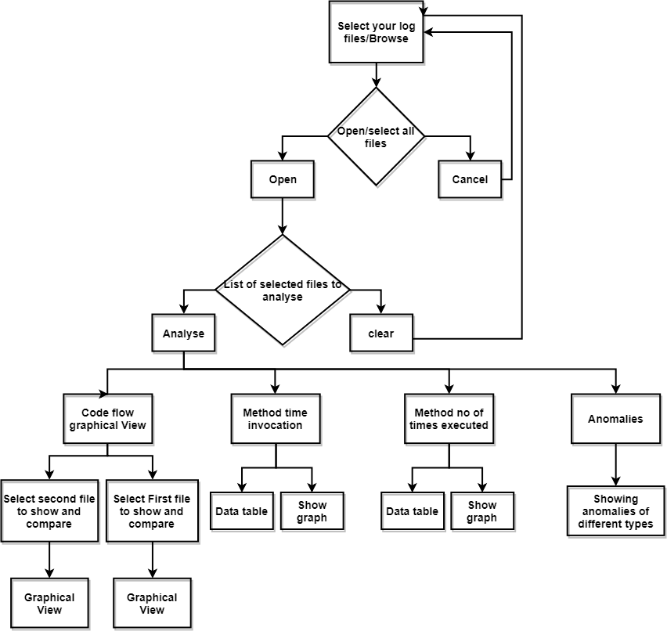
Process Flow Diagram

Slide 7
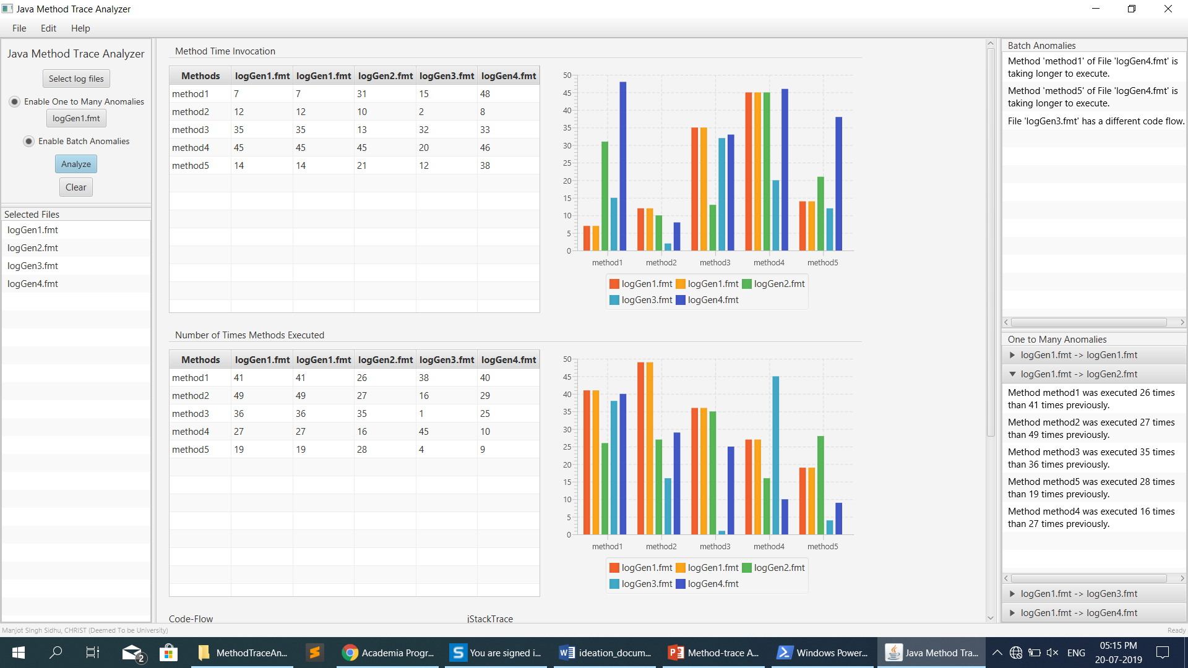
Screenshot of Solution

Slide 8
Functional Requirements
HARDWARE REQUIREMENTS
Same as Standard OpenJDK 8 system requirements:
Specified in web link below:
https://java.com/en/download/help/sysreq.xml
Minimum Requirement:
RAM: 128 MB
Disk Space: 100 MB
SOFTWARE REQUIREMENTS
Operating system as per OpenJDK 8
Link given below:
https://java.com/en/download/help/sysreq.xml
Develop & Tested on OS:
Windows 10, Ubuntu 16.04 LTE
Software used for development:
OpenJDK 8
NetBeans IDE 8.2
Apache Maven 3.39

Slide 9
Highlighting points
Below are some of the highlighted points which are specially taken care of during UI/UX:
Batch Anomalies and One to many anomalies directly notifies about performance, hang, longer execution time issues.
One page nested split pane design for comparing and analyzing log files with anomalies and data.
Accordion tabs for better and understandable view for one to many anomalies.
Detailed and scrollable main view.
Scalable and flexible graph with different colours of bars to represent different files.
In-depth summary for long jStackTrace of methods.

Slide 10





Thank you
Manjot Singh Sidhu
9876471747
Manjot.singh@btech.christuniversity.in
Christ University, Bengaluru

